Slide 1

ZChirp: Speeding Up LPWANs by Combining the Chirp with Binary Sequences
Zhenghao Zhang
Department of Computer Science
Florida State University
USA

Slide 2

Low Power Wide Area Networks (LPWAN)
Serve a a large area with many nodes
LoRa, NB-IoT, LR-FHSS

Slide 3

LoRa
LoRa has attracted a lot of attentions
Long communication range
Simplicity
Successful business management

Slide 4
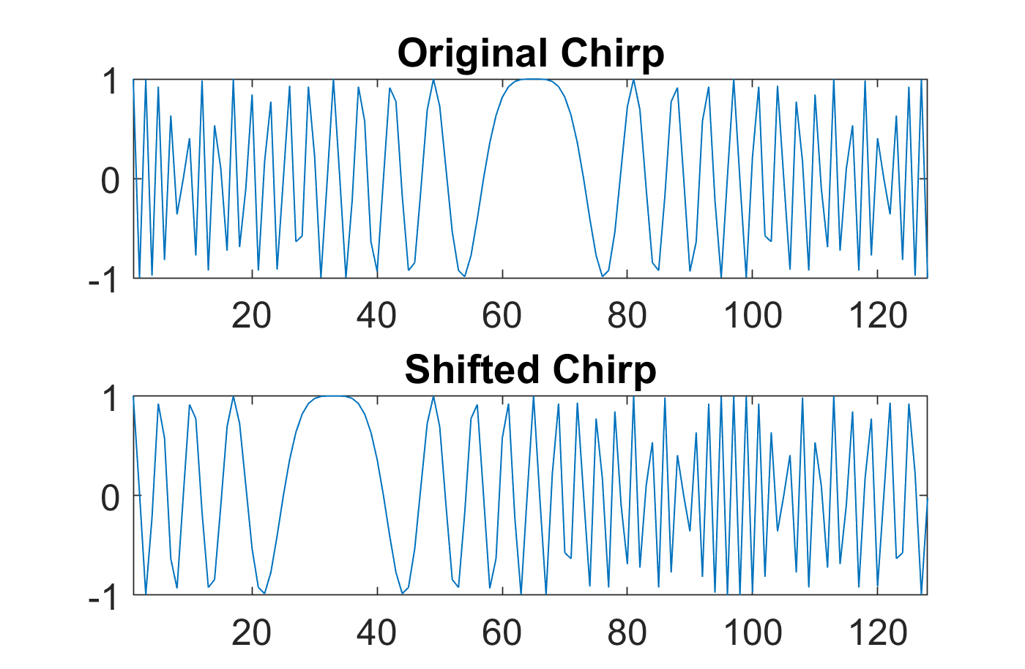
LoRa Modulation
Modulation based on Chirp, which is a complex vector with increasing frequency
Chirp length is 2^{SF}, where SF is called the spreading factor
To transmit data t (0<=t < 2^{SF}) is to cyclically shift the chirp to the left by t locations
The shifted chirp is called a symbol
A symbol therefore modulates SF bits

Slide 5
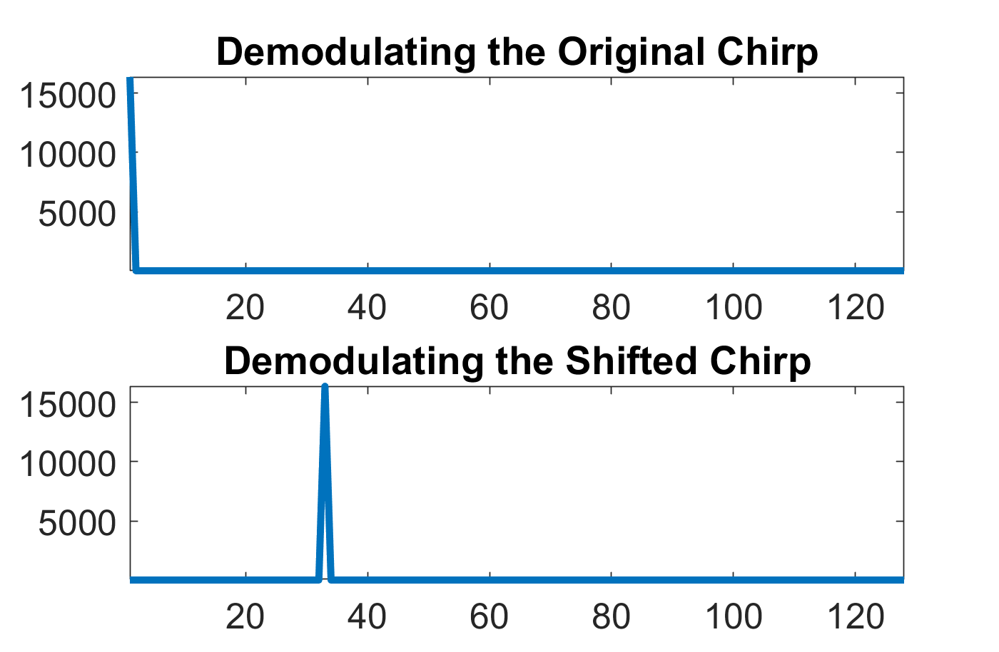
LoRa Demodulation
Divide the received vector by the chirp
If shifted t locations, will be turned into a sinewave with t cycles
FFT
Will generate a peak at t

Slide 6
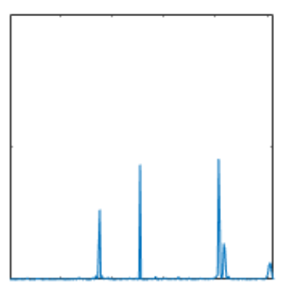
Challenges
LoRa really does not support a high capacity
When multiple nodes transmit simultansouly, the packets are likely lost
LoRa nodes (Class A) however are allowed to transmit any time they want to
1
2
3

Slide 7
Existing Solutions (Category 1)
Resolve the collision at the gateway without changing the LoRa node
Choir [Sigcomm’17]
mLoRa [ICNP’19]
Ftrack [IEEE/ACM Transactions on Networking 2020]
CoLoRa[Infocom’20]
Nscale [Mobisys’20]
SCLoRa [ICNP’20]
Pyramid [Infocom’21]
AlignTrack [ICNP’21]
Pcube [Mobicom’21]
CIC [Sigcomm’21]
TnB [CoNEXT’22]
…

Slide 8
Existing Solutions (Category 2)
How about redefining the chirp
CurvingLoRa [NSDI’22]

Slide 9

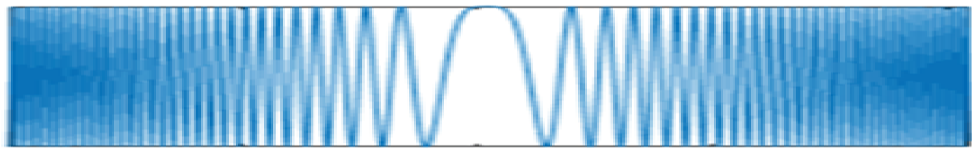
ZChirp
The main idea is to multiply a binary sequence, called Z sequence, with the chirp
A Z sequence can be thought of as a random binary vector
Z Sequence
1 -1 1 1 - 1 1 -1 -1 -1 1 1 -1 1 … 1

Slide 10
Benefit of Multiplying the Binary Sequence
Enabling multiple simultaneous transmissions and higher overall network capacity
Chirps multiplied with different Z sequences cause low interference to each other
Additional data can be modulated with the Z modulation, i.e., using different Z sequences for different data values
1 -1 1 1 - 1 1 -1 -1 -1 1 1 -1 1 … 1

Slide 11
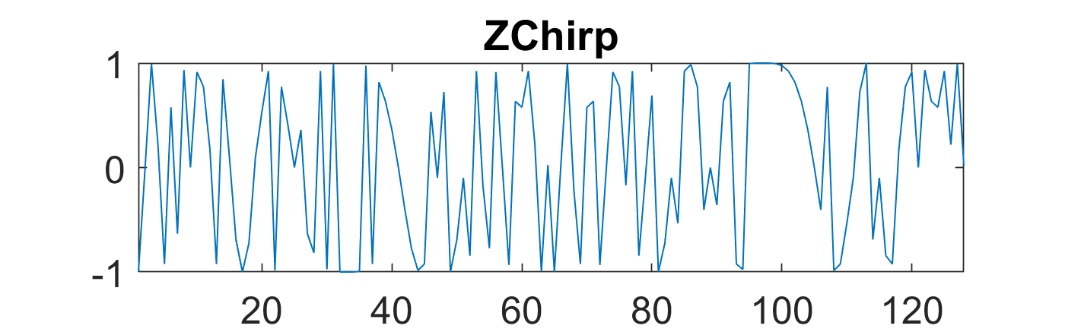
ZChirp Modulation
Shift modulation (SF bits): Traditional modulation with Chirps
Phase modulation (2 bits): rotate the shifted chirp by 0°, 90°, 180°, or 270°
Z modulation (SF bits): multiply the shifted&rotated chirp by a Z sequence
There are 2^{SF} Z sequences

Slide 12
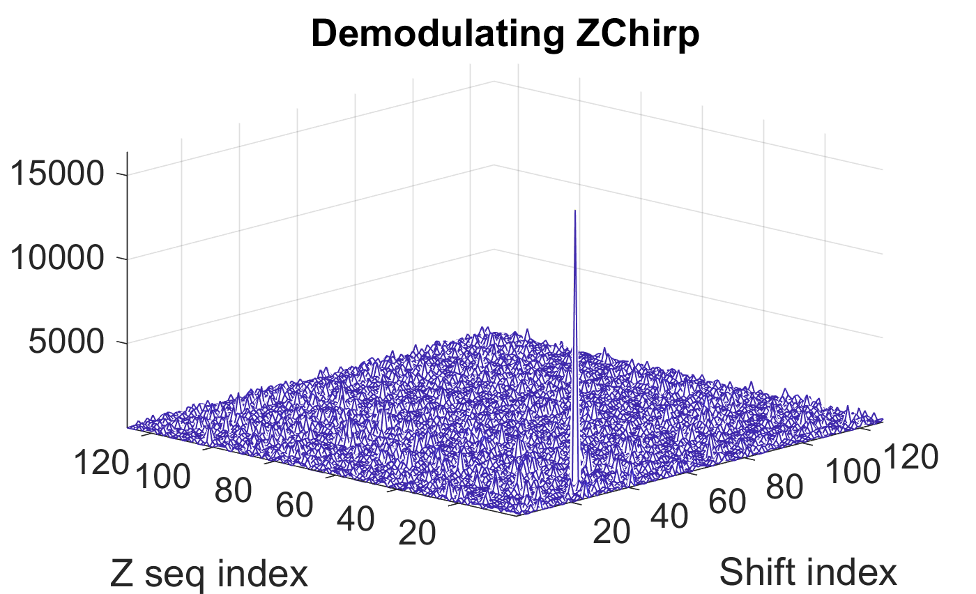
ZChirp Demodulation
Multiply the received vector with all Z sequences
FFT
The highest value achieved with Z sequence h and frequency k means Z modulation is h and shift modulation is k
Examing phase of the peak
Actual complexity much smaller with some tricks

Slide 13
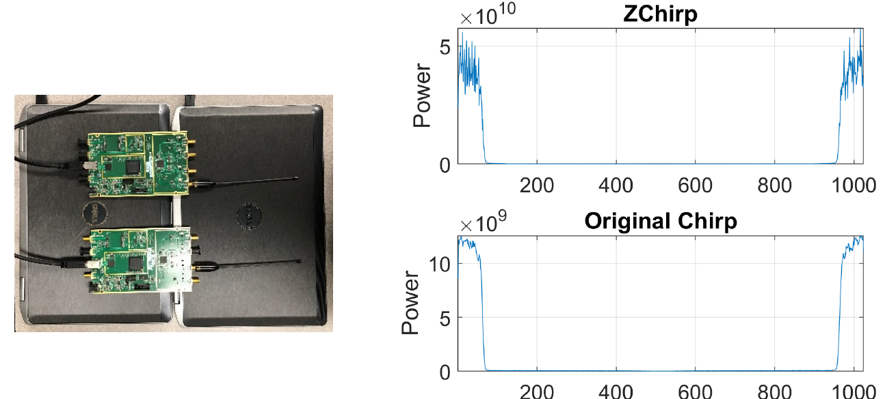
No Side Effects (1 of 3) – Does not Use More Bandwidth
Multiplying the chirp with a Z sequence basically creates a random vector with energy evenly distributed within the same bandwidth of the chirp

Slide 14
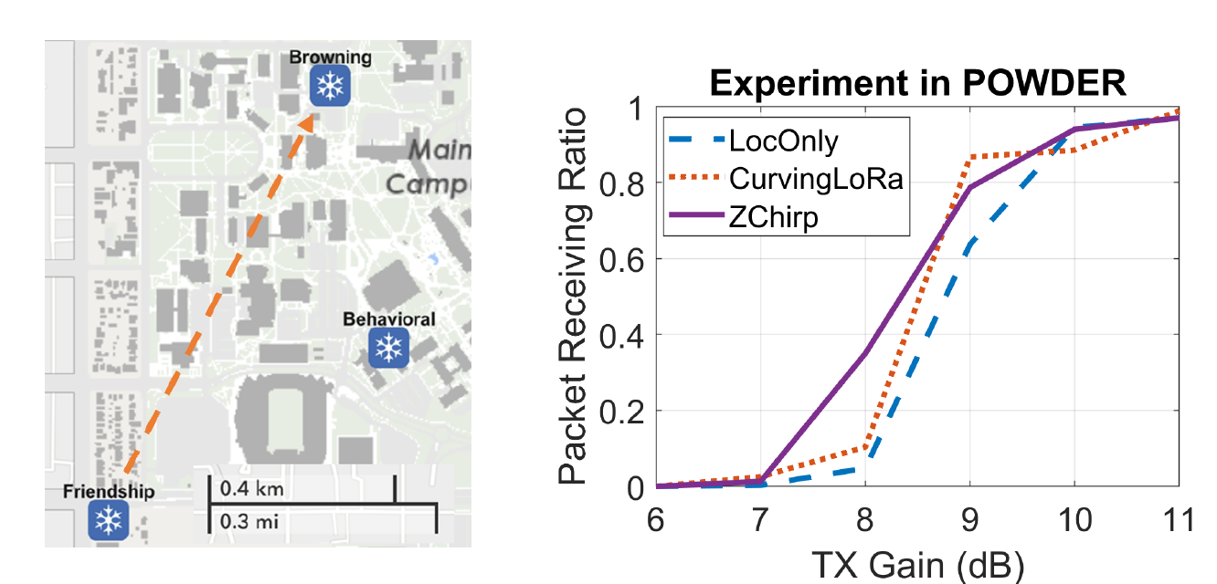

No Side Effects (2 of 3) – Does not Reduce the Communication Range
POWDER platform: University of Utah with rooftop radios some over 1 km away
LocOnly: Traditional LoRa modulation
Varying the TX gains of the transmitters
ZChirp has a higher Packet Receiving Ratio than LocOnly
Data rate of ZChrip: 1.33 X that of LocOnly

Slide 15
No Side Effects (3 of 3) – Does not Increase Node Transmission Power and Complexity
Z sequence only changes the signs of the transmitted samples

Slide 16
Coping with the Main Challenge – Demodulation Complexity
Cannot really do so many vector multiplications and FFT
Demodulating a ZChirp symbol takes no more than 9N complex multiplications and N^{2.5}/2^{0.5}complext additions where N=2^{SF}

Slide 17
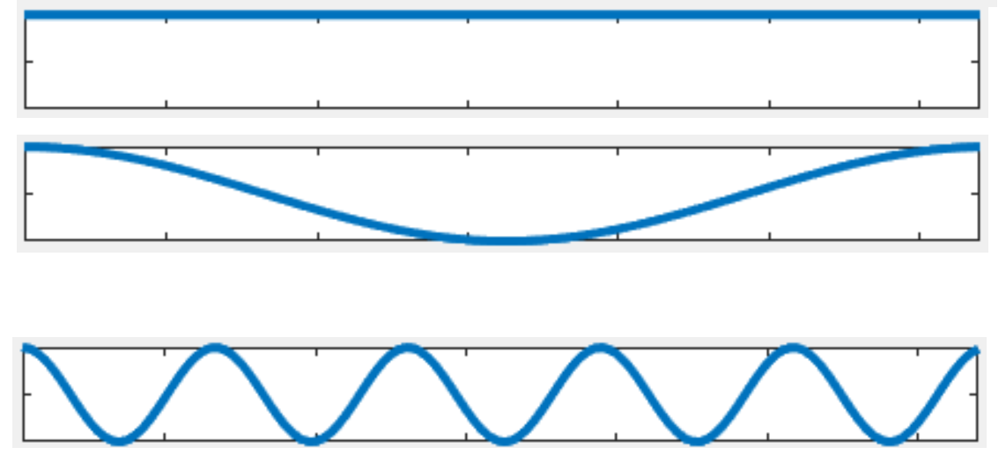
No Need of FFT
Q : Received vector didvided by the chirp elementwisely
Ξ: A matrix, Ξ ^{h} (row h) is Q multiplied Z^{h} elementwisely then FFT
Ψ : A matrix, Ψ^{t} (row t ) is Q_{t} multiplied with W^{t} (sinusoid with t cycles).
Turns out Ξ^{h} is simply adding/subtracting rows in Ψ accotding to Z^{h}
Z^{h}
Ψ
₁
+
Q₀
₋₁
-
Q₁
.
.
.
.
.
.
.
.
.
.
.
.
₁
+
Q₅
.
.
.
.
.
.
.
.
.
.
.
.
Ξ^{h}

Slide 18
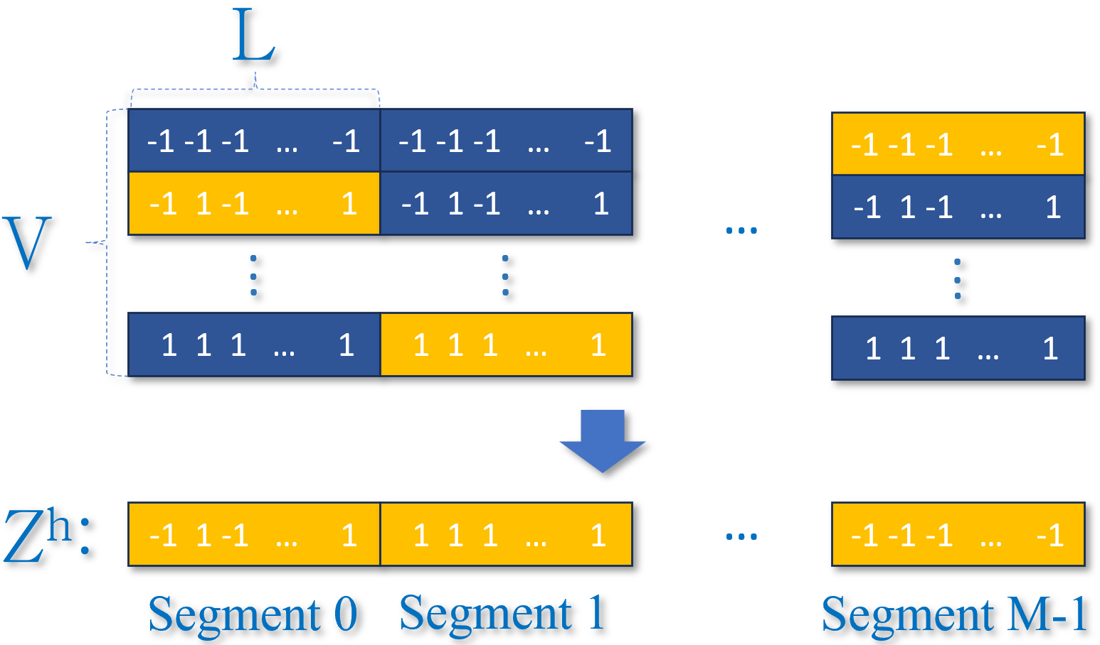
Z Sequence Construction
Each Z sequence is the concatenation of M segments
Each segment can be selected from one of V segment patterns

Slide 19
Computation in 2 Layers
ψ⁰
Summary
Ξ¹
Layer 1: adding/subtracting rows in Ψ for each segment
Layer 2: combine M partial results into the final result
Ξ²
L
.
V
.
.
.
.
.
ψ¹
.
.
.
.
.
.
.
.
.
.
.
.
.
.
.
ψ^{M-1}
Ξ^{N}
.
.
.
.
.
.
Layer 1
Layer 2

Slide 20
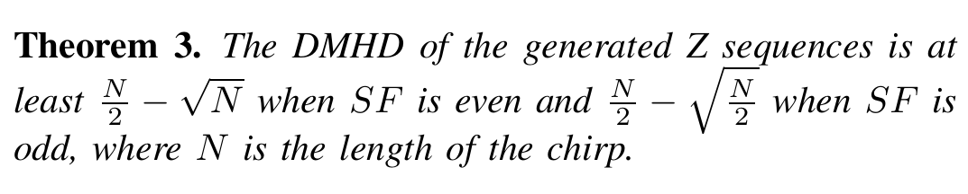
Theoretical Guarantee
Design segment patterns as different as possible from each other
Need to use Double Minimum Hamming Distance (DMHD) as the metric because if a sequence is the negative of the other the norm of their inner product is actually the maximum
Use the Reed-Solomon (RS) code to select segment patterns for each Z sequence
RS code makes sure that no two Z sequences share more than one common segment

Slide 21
Implementation Tricks
To obtain Ψ^{t}, no need to really multiply Q_{t} with all elements in W^{t}
Just 1/8 of it because others are just flipping signs/swapping real and imaginary parts
Can further reduce to 9 multiplications for the 9 points evenly distributed from 1 to e^{iπ/4} then linear interpolation
To obtain Ξ, no need to really add all elements in Ψ
Just 1/4 of it because only the first quarter of the columns need to be be added, others are just flipping signs/swapping real and imaginary parts

Slide 22
Evaluation
Evaluation includes experiments in the POWDER platform and simulations with the LTE ETU channel model

Slide 23
Compared Schemes
TnB [CoNEXT’22]
Best receiver that decodes collided LoRa packets so far
Representing traditional LoRa
Original implementation (https://github.com/raghavrathi10/TnB)
CurvingLoRa [NSDI’22]
Achieved over 5-fold the performance of LoRa
Representing solutions that modify the chirp
Original implementation for modulation, others sharing the same code base as ZChirp (https://github.com/liecn/CurvingLoRa_NSDI22)

Slide 24
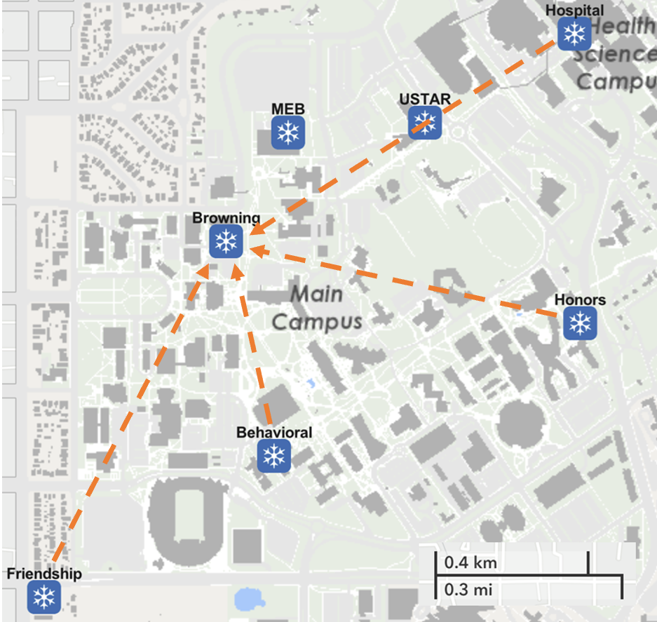
Experiments in the POWDER Platform
4 rooftop radios as nodes, one as the gateway
Nodes transmit packets at random times for 10 seconds
At the highest load, each node transmits 200 packets in 10 seconds
The gateway records the signal and write to a file to be processed
Parameters:
Packet size: 64 bytes
Carrier frequency: 3.515 GHz
Bandwidth: 125 KHz
OSF: 8
SF: 6 for ZChirp, 5 for CurvingLoRa (to match the data rate), 7 for TnB (lowest)

Slide 25
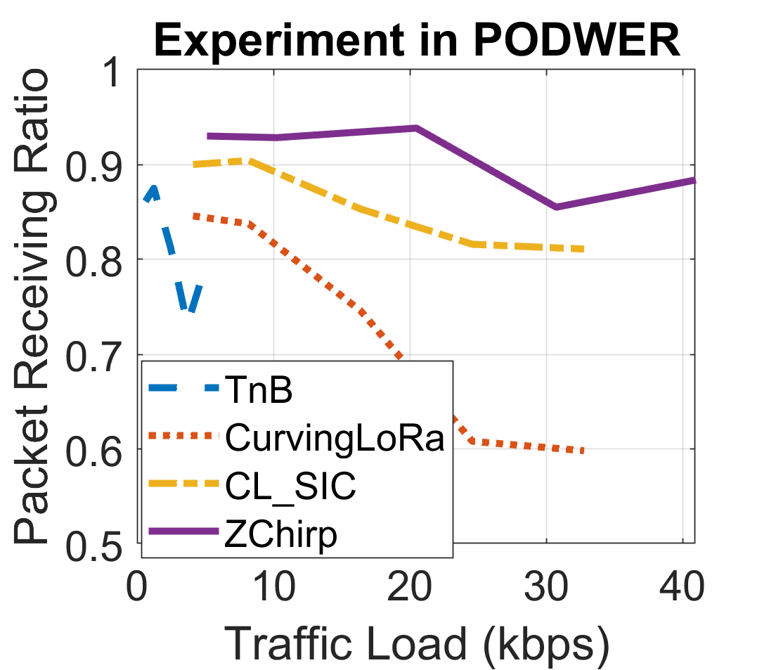
Experiments in the POWDER Platform
Network capacity: number of bits received per second when the Packet Receiving Ratio (PRR) is 0.9
Capacity of ZChirp is 22.7 kbps
TnB and CurvingLoRa cannot reach 0.9 PRR
CL_SIC: Adding Successive Interference Cancellation (SIC) to CurvingLoRa
Capacity gain of ZChirp over CL_SIC is 2.84X

Slide 26
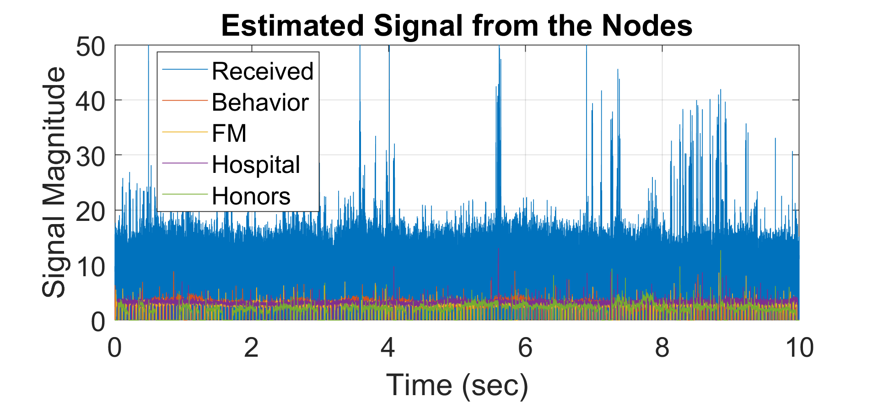
Experiments in the POWDER Platform
Signal from each node estimated by the SIC module

Slide 27
Simulations
LTE ETU model
Strong multipath components
Similar packet size and other parameters as in the experiments
Packets with the same SF has a 20 dB SNR range to simulate errors in transmission power control
SF of TnB and CurvingLoRa is SF-1 to match data rates

Slide 28
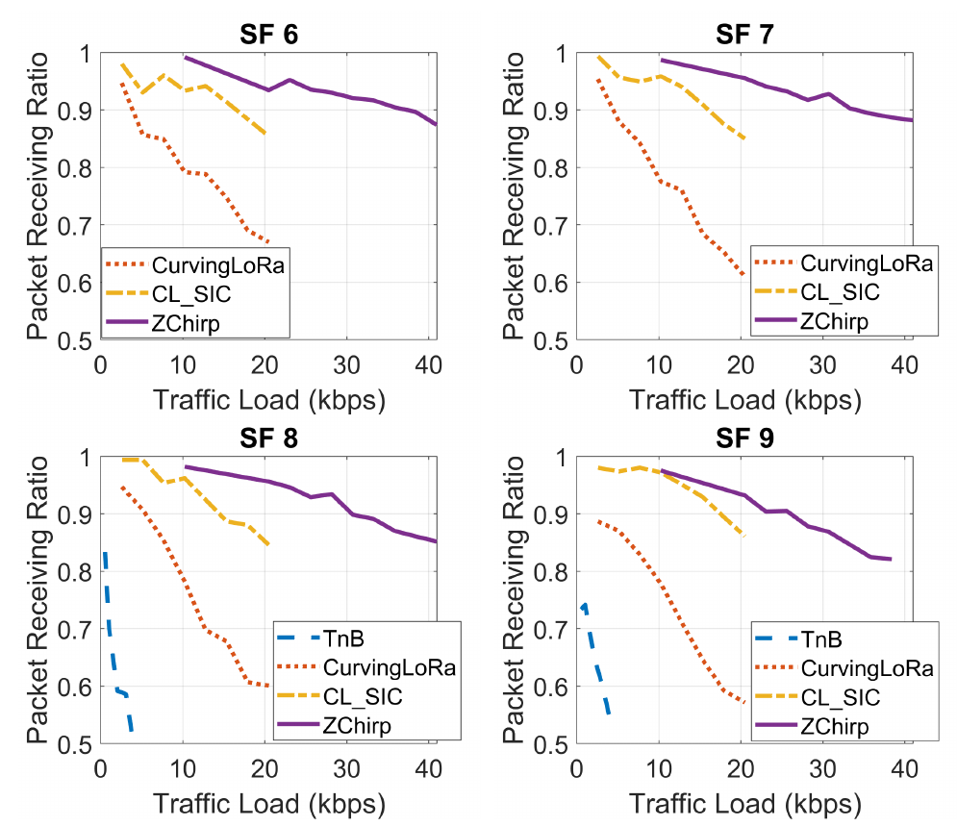
Simulations
Single SF test
All packets on the same SF
The capacity of ZChirp is about 30 kbps
Average capacity gain over CL_SIC is 2

Slide 29
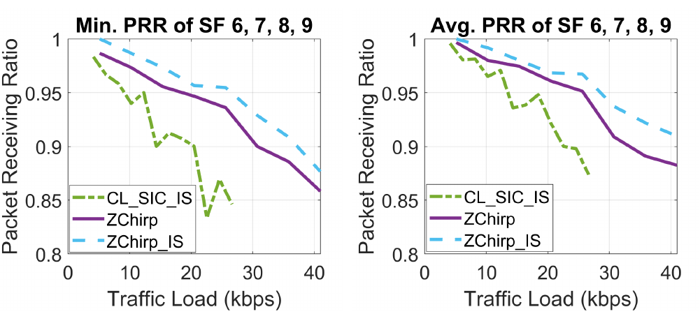
Simulations
Multi-SF tests
Equal number of packets on each SF
CurvingLoRa symbols causing problems to packet acquisition, adding ideal packet acquisition
When measured by the minimum PRR among all SFs, the gain is 1.82 X

Slide 30

This Photo by Unknown Author is licensed under CC BY-NC

